Slide 1

G2M Case Study
Virtual Internship 20-Jan-2021
Ayushi Malaviya

Slide 2

Cab Industry - Case Study (Investment Purpose)
Pharma is a private equity firm in US. Due to remarkable growth in the Cab Industry in last few years and multiple key players in the market, it is planning for an investment in Cab industry.
The goal is to offer practical recommendations to aid Pharma company in selecting the most suitable firm to invest in.
The analysis has been divided into four parts:
Data Exploratory Analysis
Finding the most profitable Cab company
Recommendations for investment

Slide 3
Data Exploratory Analysis
Features: 16 features including 6 derived features.
24 Features( including 9 derived features)
Timeframe of the data: 2016-01-31 to 2018-12-31
Total data points :359392
Assumptions:
The calculation of ride profits is based on keeping other factors constant and using only the Price_Charged and Cost_of_Trip features to determine profitability. In the city dataset, the Users feature is treated as the number of cab users in the city. We have made an assumption that this number includes users of other cab companies, including Yellow and Pink cabs. In the holiday dataset, the holidays are considered excluding long week breaks to avoid complexity of the model.

Slide 4
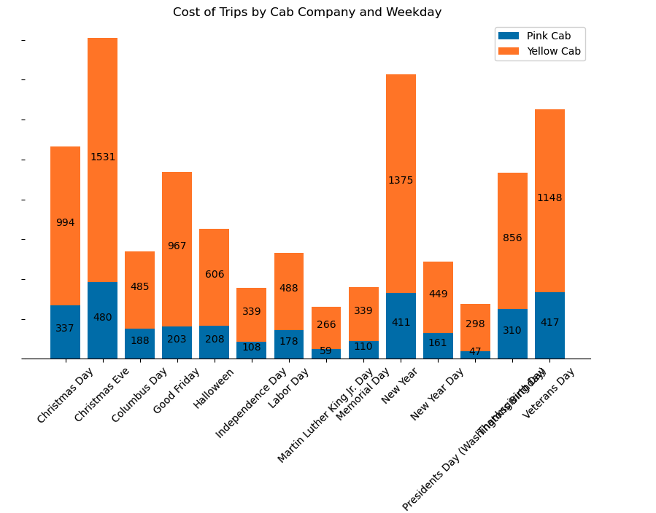
Each Cab Company Users on the holidays
Observation 1: Yellow Cab Company has more active users on holidays than Pink Cab Company. This is likely because Yellow Cab Company has a larger fleet of cabs and is able to accommodate more riders.
Observation 2: Christmas and Veteran's Day have the highest demand for cabs. This is likely because these holidays are celebrated by a large number of people and many people travel during these holidays.

Slide 5
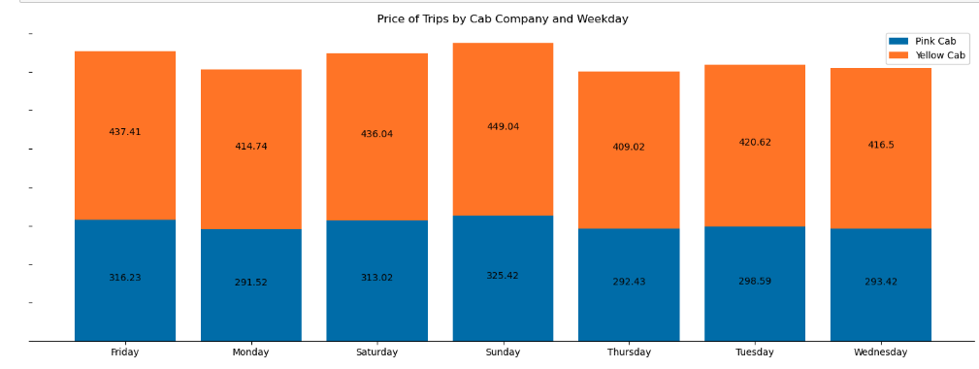
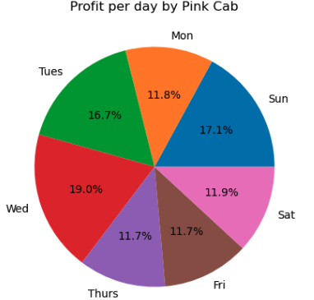
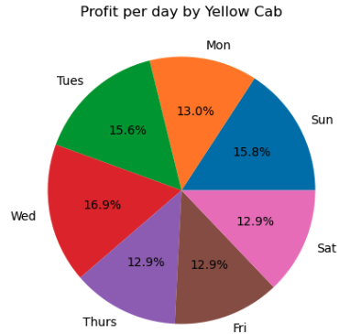
Average Profit by Company Based on Weekdays
Observation 1: Yellow Cab has a price premium over Pink Cab by 27%, with Sunday being the most expensive day for both companies.
Observation 2: Yellow Cab has consistently higher demand compared to Pink Cab with a difference of around 1 to 10 USD on most days.
Observation 3: Pink Cab experiences inconsistency in demand across different days..
Lastly, Overall profit percentage per day is clearly observed for yellow Cab

Slide 6
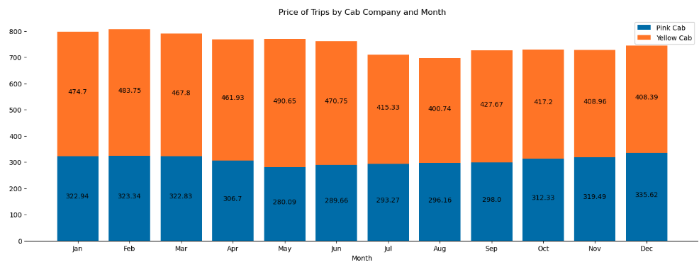
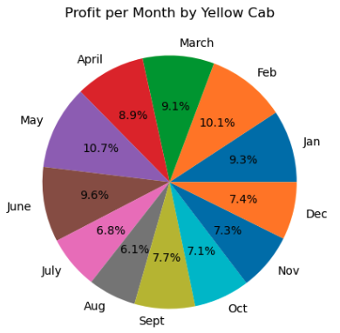
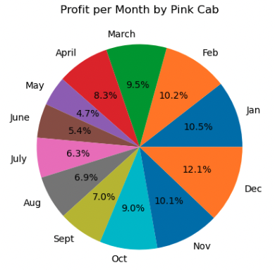
Average Profit by Company Based on Months
Observation 1: Yellow Cab has a price premium over Pink Cab by 45%, with February being the most expensive month for both companies.
Observation 2:. Yellow Cab has consistently higher demand compared to Pink Cab with a difference of around 10 to 50 USD on most days .
Observation 3: Pink Cab experiences inconsistency in demand across different month.
Lastly, Overall profit percentage per month is clearly observed for yellow Cab excluding few of the months which is negligible.

Slide 7
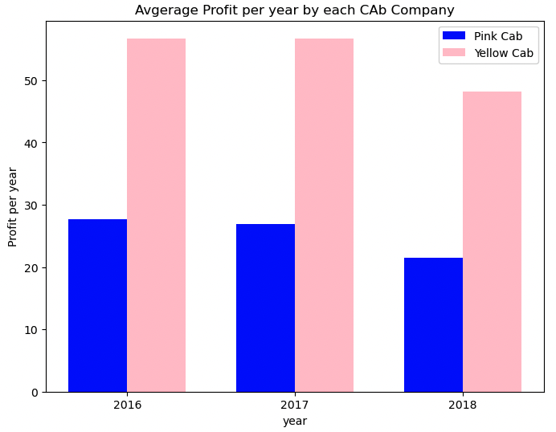
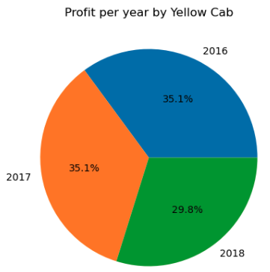
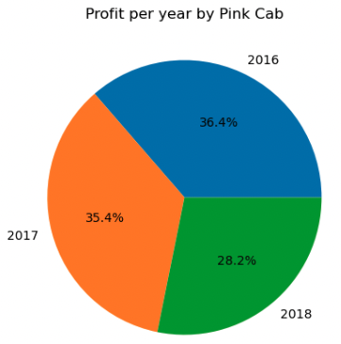
Average Profit by Company Based on Year
Observation 1: Yellow Cab has a price premium over Pink Cab by 35%, with February being the most expensive year for both companies.
Observation 2:. Yellow Cab has consistently higher demand compared to Pink Cab higher difference from Pink Cab
Observation 3: Pink Cab experiences inconsistency in user retention and experiences per year.
Lastly, Overall profit percentage per year is observed for yellow and Pink to be maginal.

Slide 8
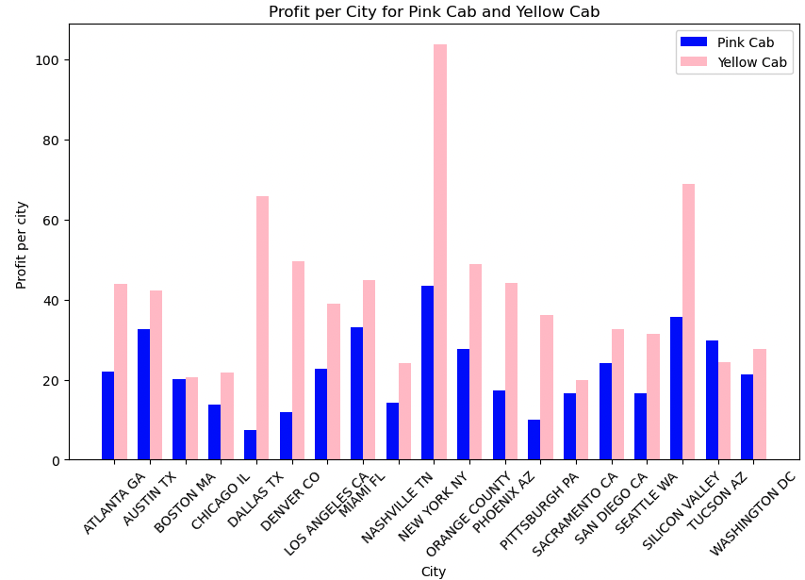
Average Profit by Company Based on City AREA
Observation 1: Yellow cab is highly profitable in each of city which means the growth of the company is optimistic.
Observation 2: The lowest profit of Yellow cab is the median of the Pink Cab.
Observation 3: Metro polytan cities have high demand of cab and trust Yellow Cab industry.

Slide 9
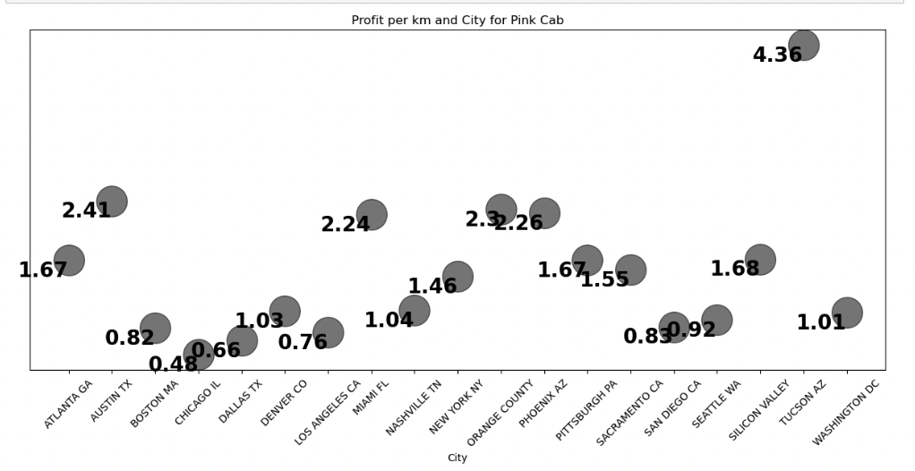
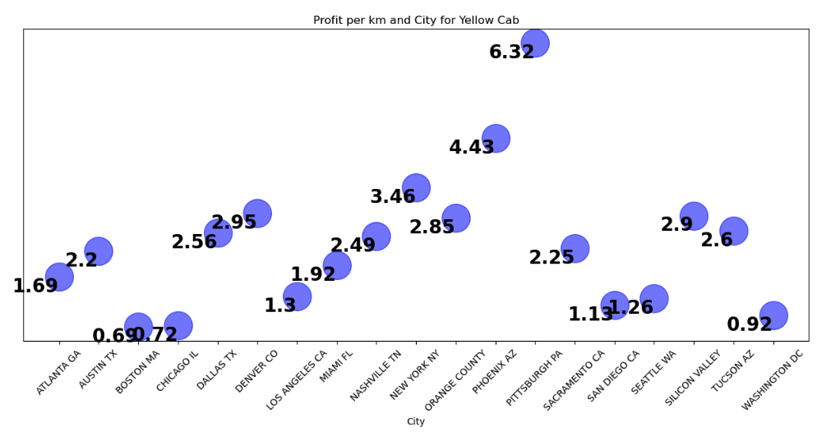
Profit per city per KM for each CAB company
Profit per km is made by yellow Cab in various city for different ranges.
Yellow cab is having margin of profit in between the range of(0.69 to 6.32) with mean of around 2.79 and median of 2.6.
However, Pink cab is having margin of profit in between the range of(0.48 to 4.36) with mean of around 1.04 and median of 1.67.

Slide 10
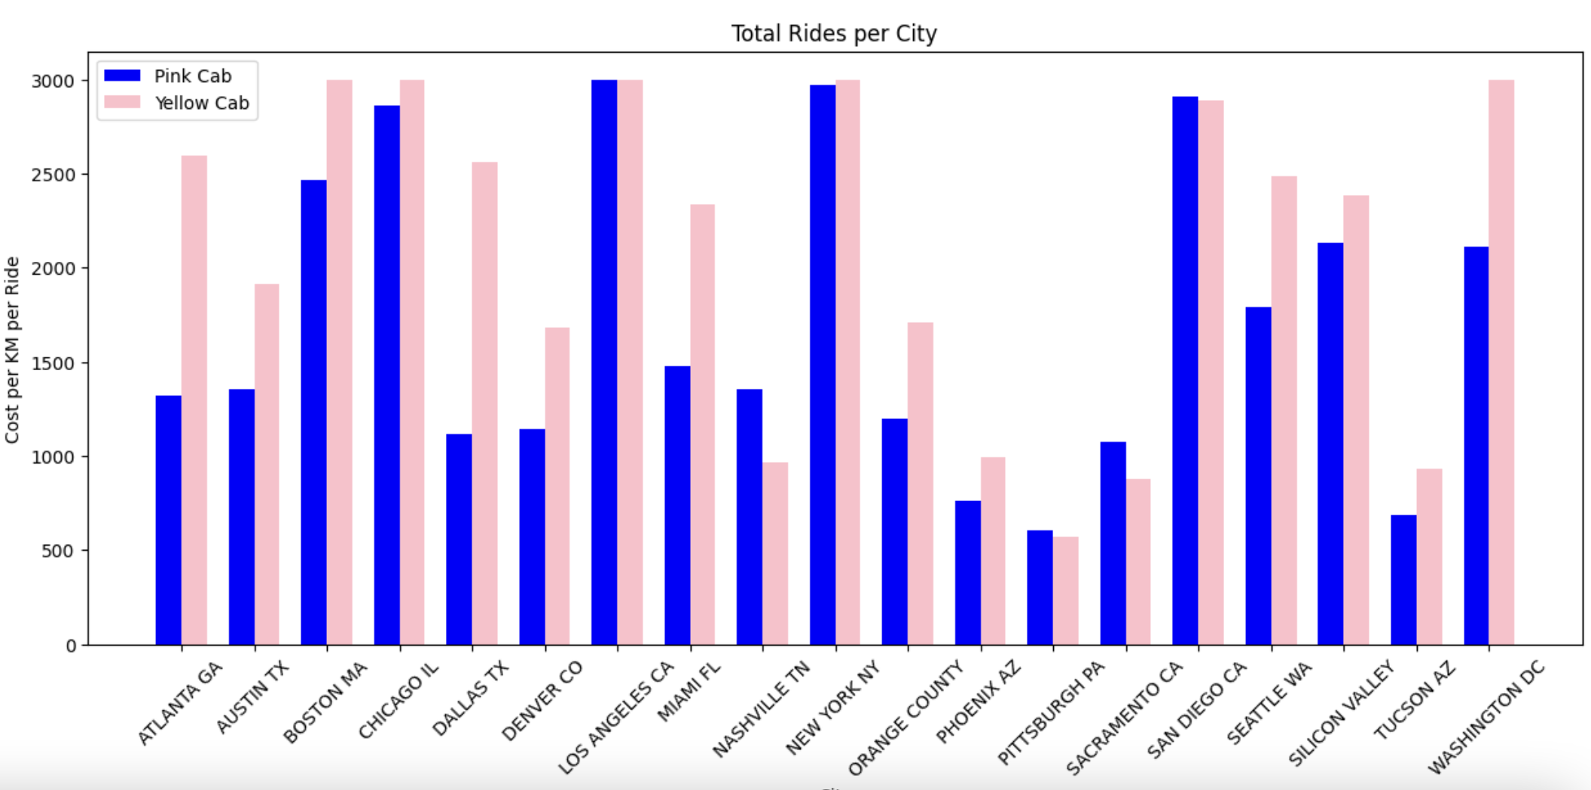

Slide 11
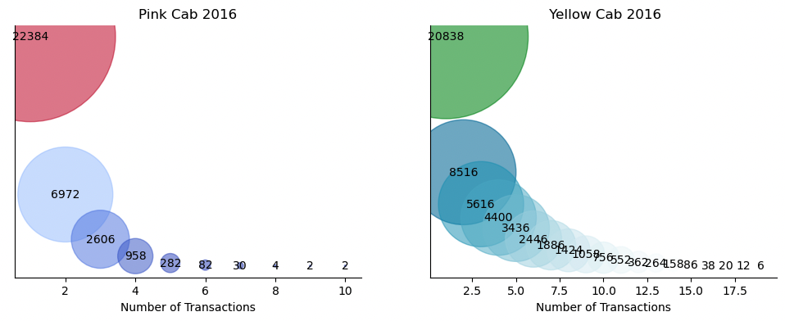
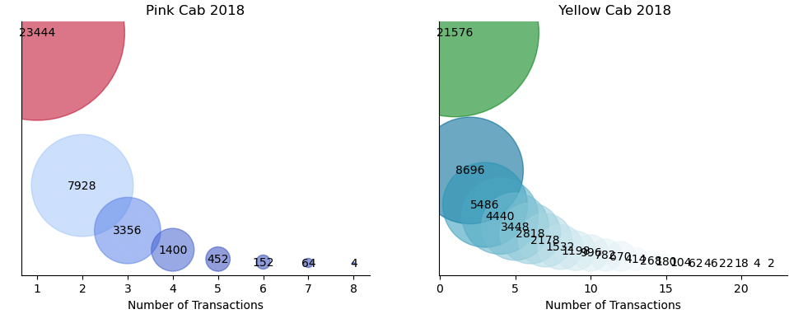
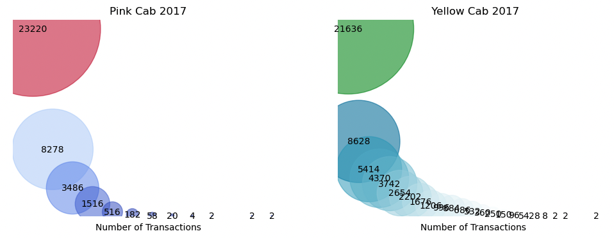
Total Rides per year By user for each Cab
Here, Number of users are highly liking and enjoying yellow cab ride. However, The ride for Pink cab is also perfered by the user at the initial point.

Slide 12
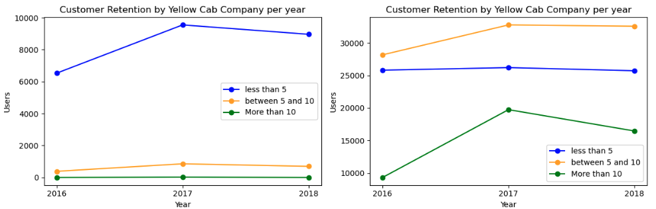
Growth of company by customer retention
Customer Retention are the regular customer of the company. By the above graphs, We can observe that customer of Yellow Cab Company is having great number of user who are riding more than 20 times in compared to Pink Cab Company

Slide 13
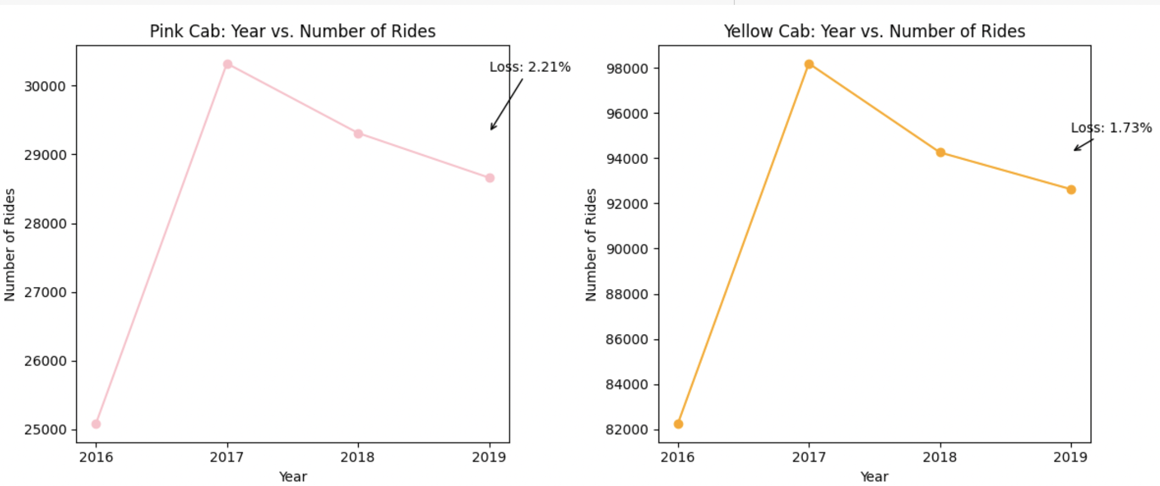
Forecasting of No. of Rides for 2019 year

Slide 14
Conclusions
Evaluated both the cab companies on following points and found Yellow cab better than Pink cab:
Customer Reach : Yellow cab has higher customer reach in 25 cities while Pink cab has higher customer reach in 4 cities, ultimately increase profit possibilities for yellow cab compared to Pink cab
Customer Retention: analyzed this in their segments : at least 5 drive ,at least 10 drive and more than 10 with the same cab company. I found that Yellow cab is doing far better than Pink cab in both these segments.
Seasonality: During holidays and summer, cabs demands increases. However, It is observed that yellow cab has more demand compared to pink cab.
Average Profit per KM: Yellow cab’s average profit per KM is almost three times the average profit per KM of the Pink cab.
Ride count and Profit Forecasting : Both the companies are facing loss in the while gaining profit and increasing number of rides. Yellow cab’s forecasted profit loss is around 1.73% while Pink cab’s loss in 2.21%. Pink cab is facing more loss when its forecasted no of ride loss is lesser than Yellow cab.
Based on above analysis , Yellow cab company is better for investment.

Slide 15
Thank you

